Slide 1
An Updated Overall Survival Analysis With Correction for Protocol-Planned Crossover of the International, Phase III, Randomized, Placebo-Controlled Trial of Regorafenib in Advanced Gastrointestinal Stromal Tumors After Failure of Imatinib and Sunitinib (GRID)
Abstract 110
Demetri GD, Reichardt P, Kang Y-K, Blay J-Y, Joensuu H, Schäfer K, Kuss I, Kappeler C, Casali PG, on behalf of the GRID Investigators

Slide 2
Background
Imatinib and sunitinib are the approved first- and second-line therapies for gastrointestinal stromal tumors (GIST)¹
Most metastatic GIST patients eventually develop resistance to these agents
Regorafenib (REG) is an oral multikinase inhibitor that blocks the activity of multiple protein kinases, including those oncogenically activated in GIST, as well as others involved in the regulation of angiogenesis and the tumor microenvironment²
In the phase III GRID trial, REG significantly improved progression-free survival (PFS) versus placebo (PBO) in patients with advanced GIST that had progressed during treatment with at least imatinib and sunitinib (HR 0.27; 95% CI 0.19-0.39; one-sided P<.0001)³
No significant difference in overall survival (OS) was observed at the time of the primary analysis (HR 0.77;95% CI 0.42-1.41; one-sided P = .199).³ However, this result was likely confounded by the high rate of crossover from PBO to REG (85%) at the time of progression
1. ESMO/European Sarcoma Network Working Group. Ann Oncol. 2014;25(Suppl 3):iii21–iii26. 2. Wilhelm SM, et al. Int J Cancer. 2011;129:245-255. 3. Demetri GD, et al. Lancet. 2013;381(9863):295-302.
Demetri GD, et al. J Clin Oncol. 2015;33(suppl 3): Abstract 110.

Slide 3
Objective
We conducted exploratory analyses of updated OS data to assess the impact of protocol-planned crossover from PBO to REG on OS for patients initially randomized to PBO
Demetri GD, et al. J Clin Oncol. 2015;33(suppl 3): Abstract 110.

Slide 4
Methods
GRID study design
GRID (ClinicalTrials.gov identifier: NCT01271712) was a randomized, double-blind, PBO-controlled, international, multicenter, phase III trial
The primary endpoint was PFS; OS was assessed as a secondary endpoint
At the time of centrally assessed tumor progression, treatment assignment was unblinded, and patients in the PBO group could cross over to REG
RANDOMI
ZAT
ION
Disease progression per independent blinded central review
OFF
TREATMENT
Metastatic/ unresectable GIST progressing despite at least prior imatinib and sunitinib
(n = 199 randomized)
REG + BSC
(n = 133)
160 mg once daily
3 weeks on, 1 week off
Unblinded
crossover offered for PBO arm or continued REG for treatment arm
PBO + BSC
(n = 66)
3 weeks on, 1 week off
REG (unblinded)
until next progression (n = 97)
2:1
Demetri GD, et al. J Clin Oncol. 2015;33(suppl 3): Abstract 110.

Slide 5
Statistical Methods
The data cut-off for the updated OS analysis was January 31, 2014, two years after the primary analysis
OS in patients originally randomized PBO was corrected using the rank-preserving structural failure time method (RPSFT)¹ and the iterative parameter estimation method (IPE)²
These methods are both considered as the best choice among all correction analyses³
Both methods assume validity of the accelerated life model, which uses a multiplicative factor on the survival times to represent the treatment effect: U = T + f D, where U is the lifetime of a patient that would have been observed without REG, T is the observed time from randomization until start of REG, D is the observed lifetime after start of REG for patients in both treatment arms, and f is the lifetime acceleration factor representing the effect of REG on lifetime after start of REG
HRs and 95% CIs were derived using the Cox model (CIs do not include modeling uncertainties; true CIs maybe larger)
1. Robins JM, et al. Commun Stat Theory Methods. 1991;20:2609-2631. 2. Branson M, et al. Stat Med. 2002;21:2449-2463. 3. Morden JP, et al. BMC Med Res Methodol. 2011;11:4.
Demetri GD, et al. J Clin Oncol. 2015;33(suppl 3): Abstract 110.

Slide 6
Baseline Characteristics
 | REG (n = 133) | PBO (n = 66)
Age, median years (range) | 60 (18-82) | 61 (25-87)
Sex, n (%)
Male | 85 (64) | 42 (64)
Female | 48 (36) | 24 (36)
ECOG performance status, n (%)
0 | 73 (55) | 37 (56)
1 | 60 (45) | 29 (44)
Previous systemic anticancer therapy, n (%)
2 lines | 74 (56) | 39 (59)
>2 lines | 59 (44) | 27 (41)
Duration of previous imatinib therapy, n (%)
≤6 months | 18 (14) | 4 (6)
6–18 months | 26 (20) | 7 (11)
>18 months | 89 (67) | 55 (83)
Demetri GD, et al. J Clin Oncol. 2015;33(suppl 3): Abstract 110.

Slide 7
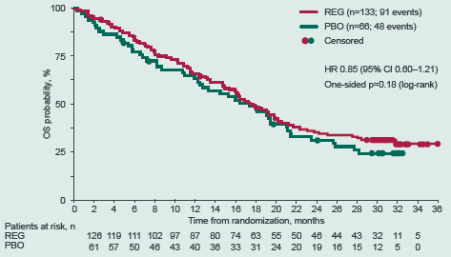
Kaplan-Meier Estimate of Updated OS in the Intention-to-Treat Population
Demetri GD, et al. J Clin Oncol. 2015;33(suppl 3): Abstract 110.

Slide 8
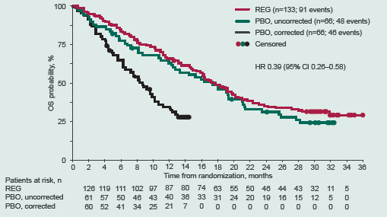
Kaplan-Meier Estimate of Updated OS With Correction for Crossover by RPSFT
Demetri GD, et al. J Clin Oncol. 2015;33(suppl 3): Abstract 110.

Slide 9
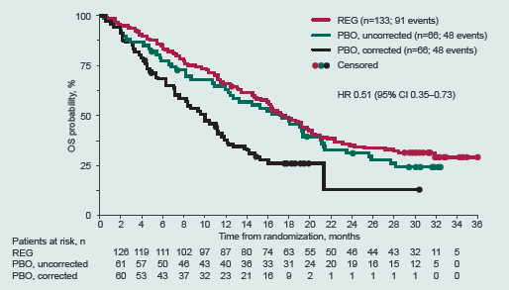
Kaplan-Meier Estimate of Updated OS With Correction for Crossover by IPE
Demetri GD, et al. J Clin Oncol. 2015;33(suppl 3): Abstract 110.

Slide 10
Conclusions
Updated OS data from the GRID trial support the results of the original analysis
Exploratory analyses correcting for the impact of crossover on OS suggest that REG has a positive impact on OS in patients with GIST
Continued REG treatment was associated with a long-term benefit in 22 patients remaining on treatment at data cut-off, with a median duration of treatment longer than 2 years
Demetri GD, et al. J Clin Oncol. 2015;33(suppl 3): Abstract 110.

